Slide 1
ChatGPT Dev Talk
Mike Benkovich – mike@benko.com – www.benkotips.com

Slide 2
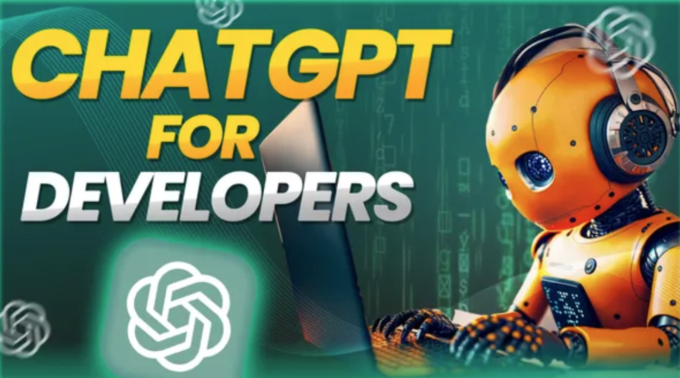

Slide 3
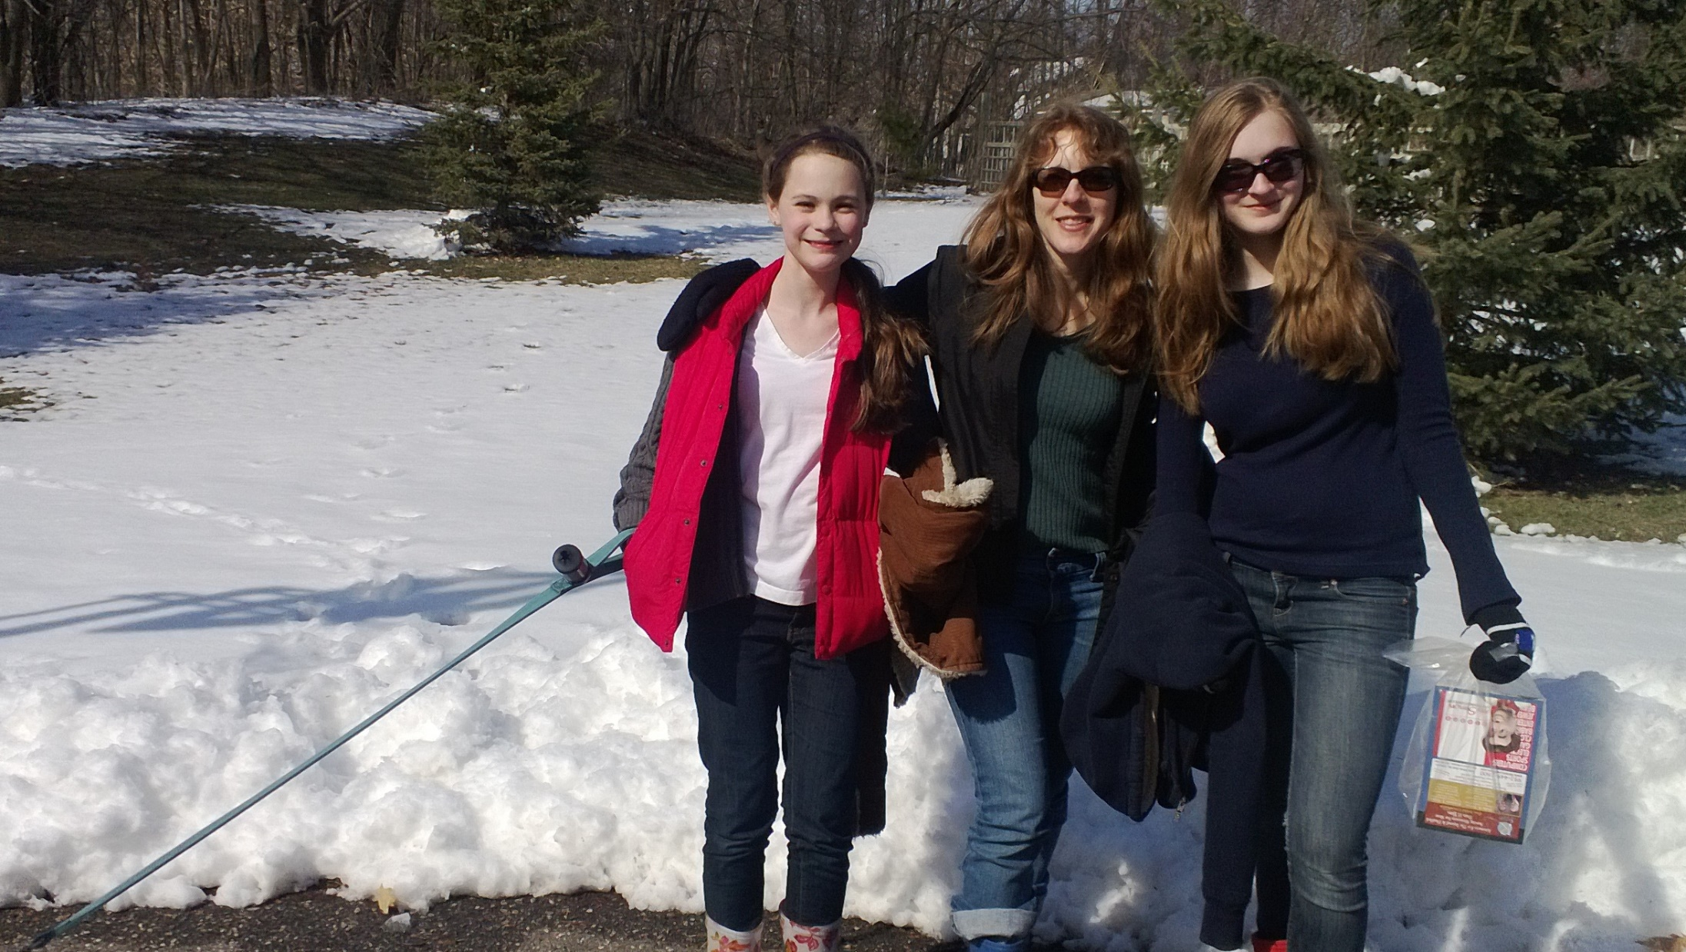

Mike Benkovich
- Enterprise Cloud Architect & Consultant
- Live in Minneapolis
- Founder of Imagine Technologies, Inc.
- Developing Courses for LinkedIn Learning
- Blog www.benkoTIPS.com
- Follow @mbenko on Twitter
Send me Feedback! mike@benko.com
- Azure Office Hours on Fridays! https://bit.ly/BnkAzHrs

Slide 4
AI - helps you make mistakes much faster and in more interesting, expensive ways.

Slide 5
Today…
Hello ChatGPT
Large Language Models
Chat and Co-pilots
OpenAI Service
Prompt Flow
Next steps…

Slide 6
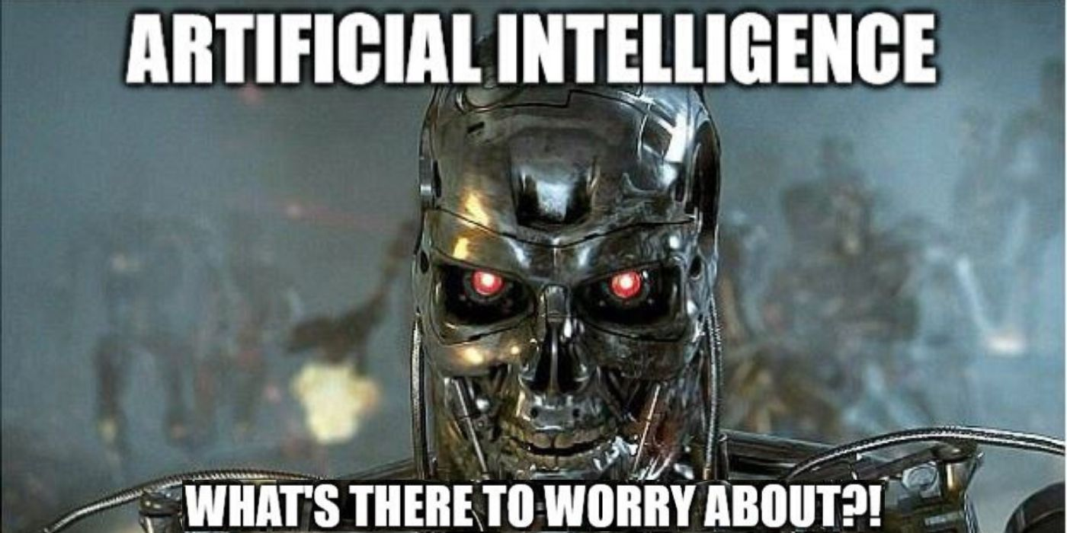

Slide 7
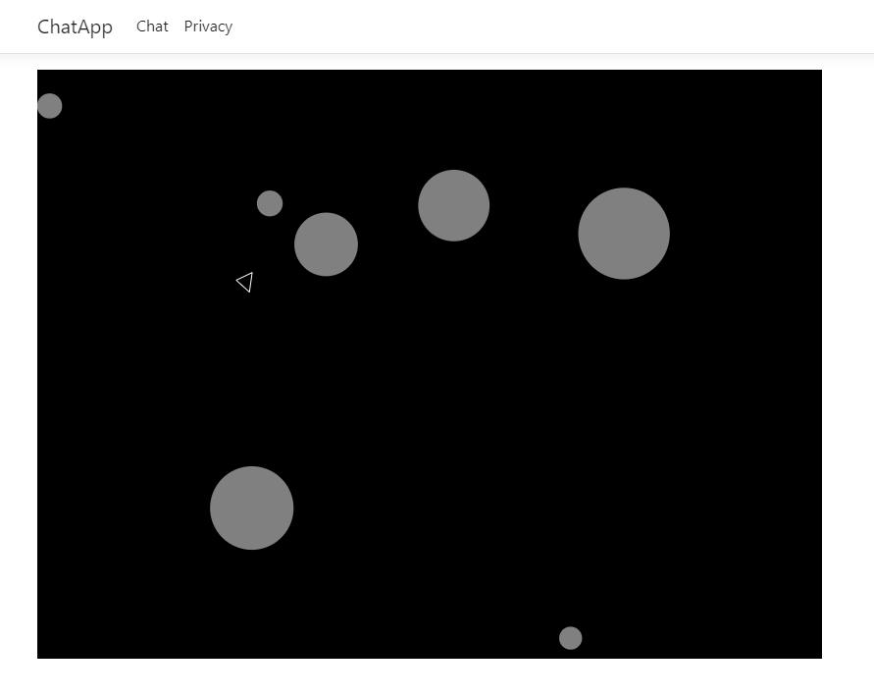
Let’s play a game

Slide 8
There are only 10 kinds of people those who understand binary and those who don’t.

Slide 9
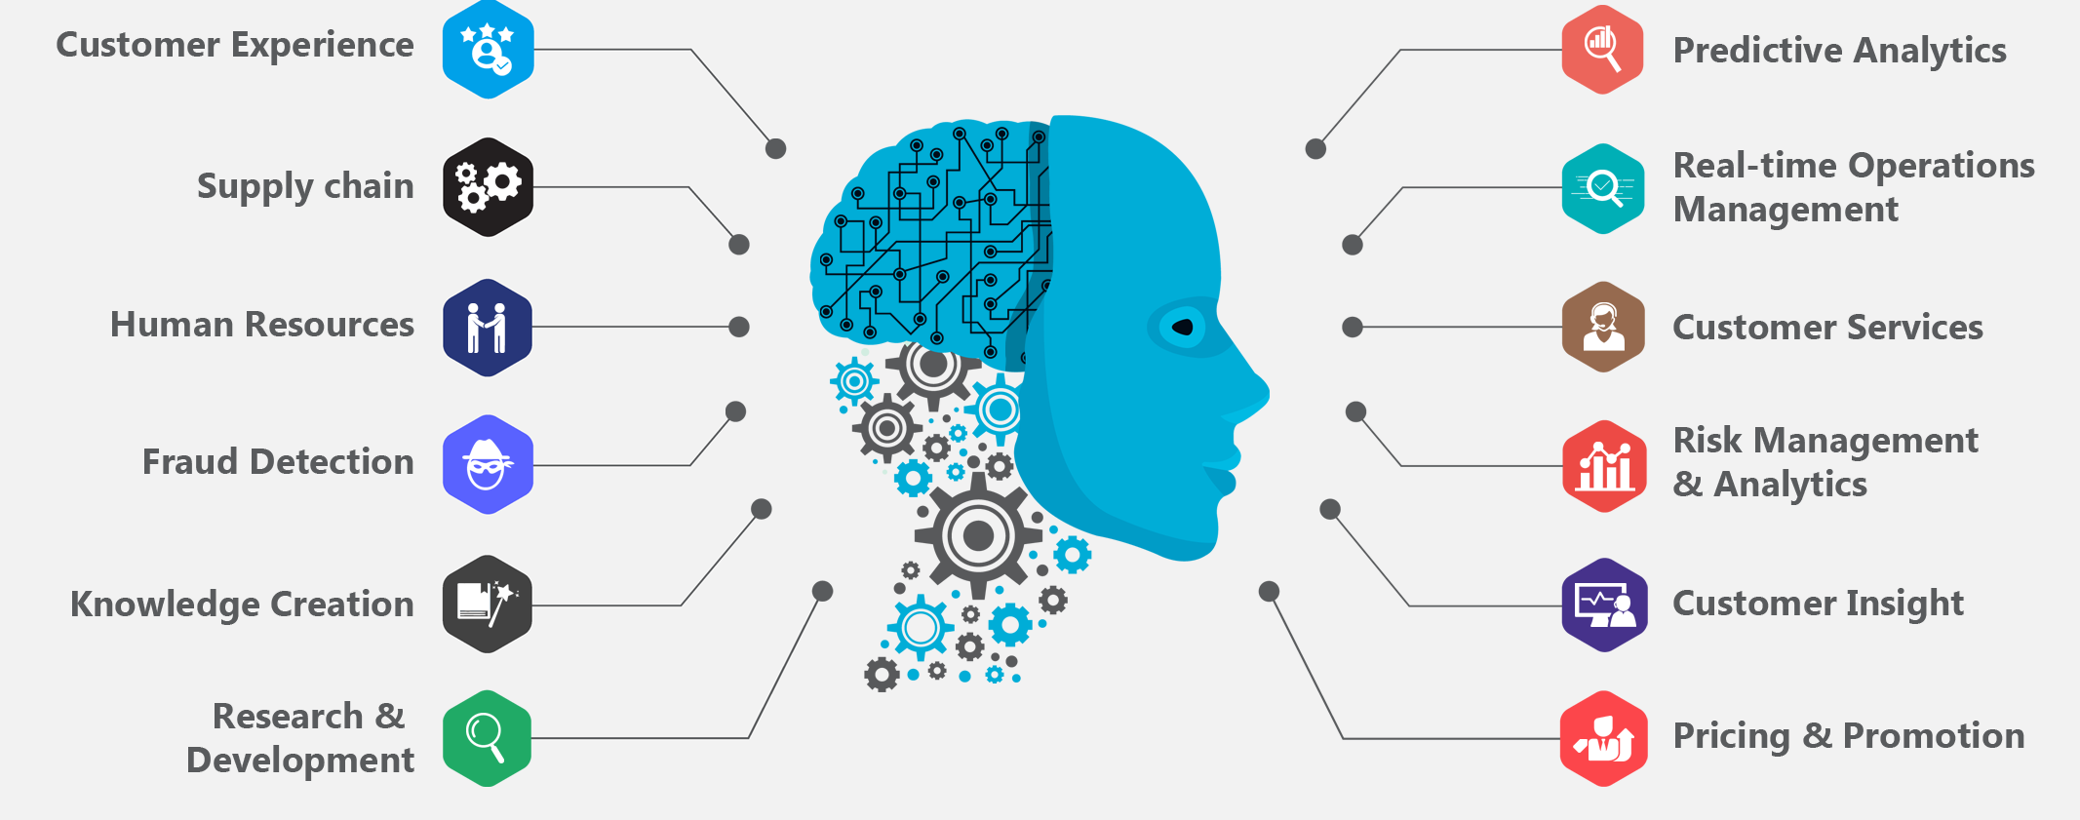
AI Scenarios

Slide 10
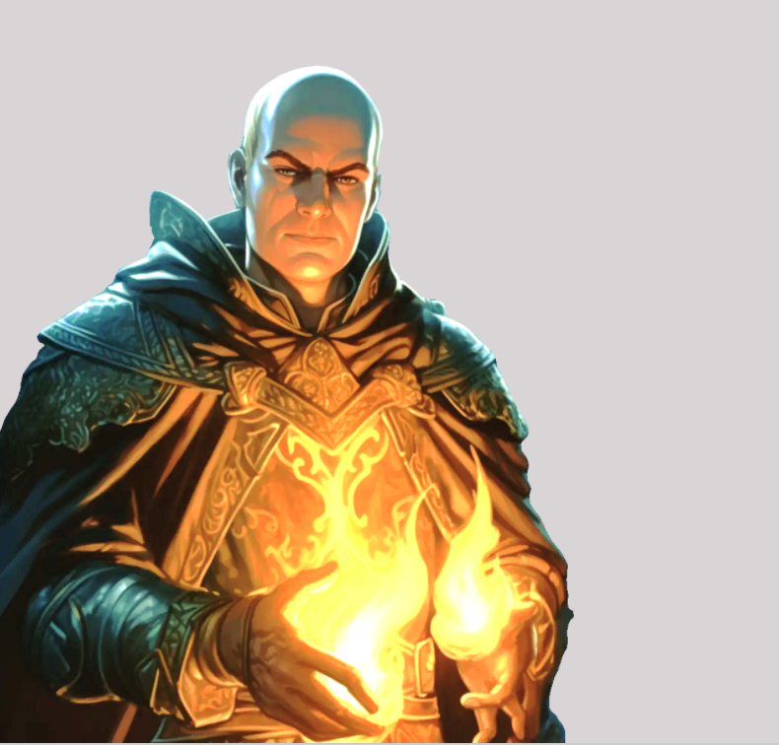
What is a LLM
Prediction engine
What comes next?
What do I know about you?
How do I figure it out?

Slide 11
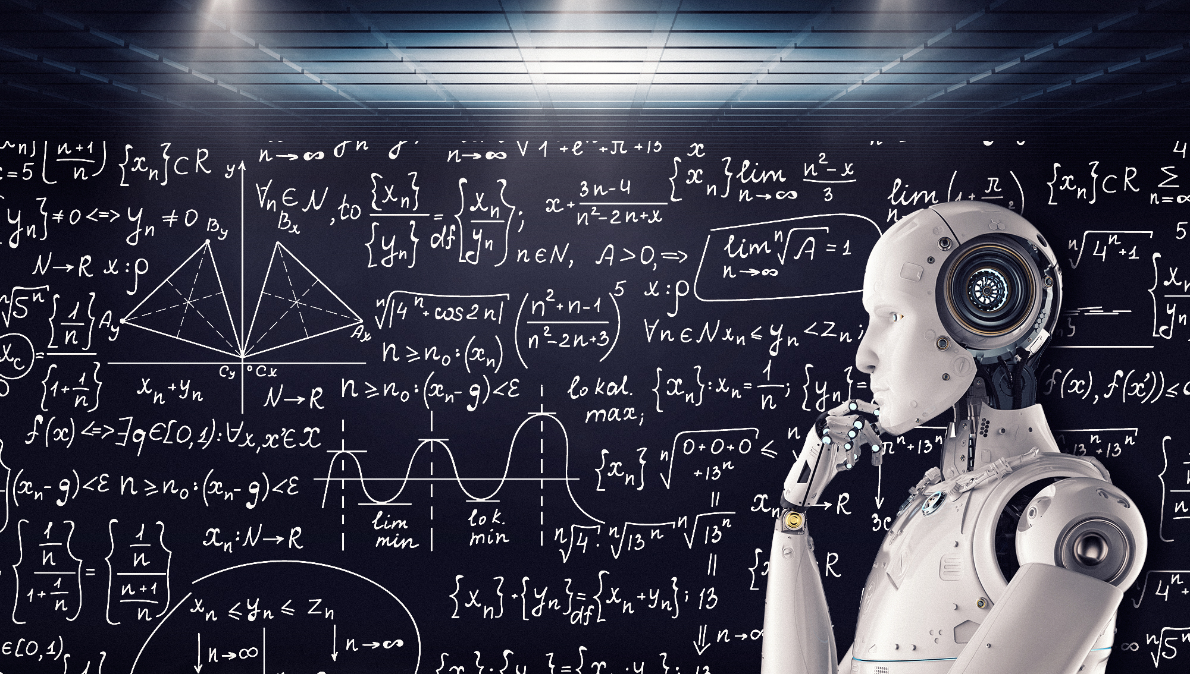
Built on Math

Slide 12
GPTs (generative pre-trained transformer)
Provide text outputs in response to inputs
Code generation
Summarization
Conversation
Creative writing

Slide 13
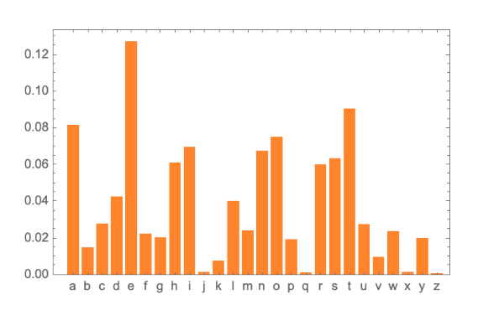
What comes next?

Slide 14
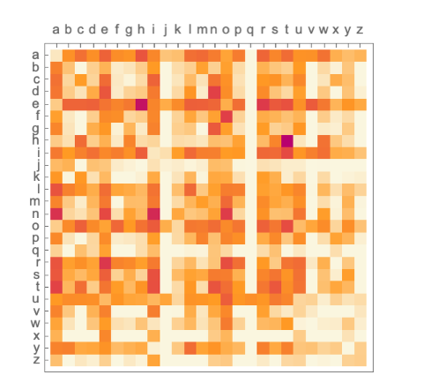
2-grams … i.e. pairs of letters

Slide 15
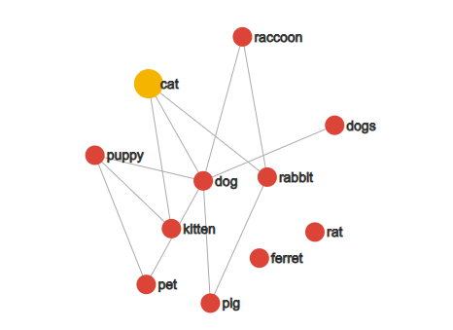
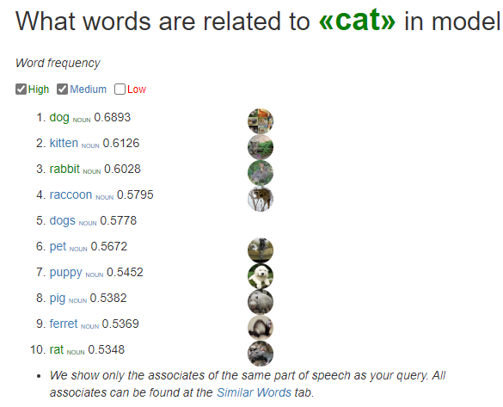
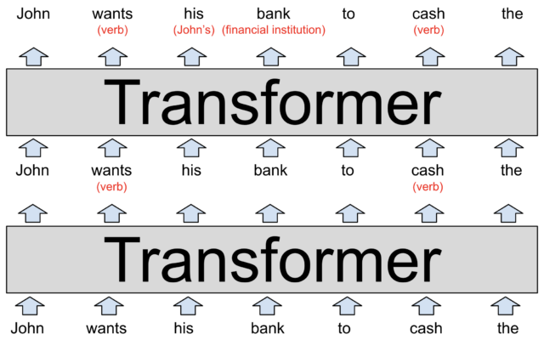
Large Language Models
Prediction engine what comes next?
Neural Network Google word2vec project 2013
Word Vector Based GPT-3 uses word vectors with 12,288 dimensions
Transformer Layers GPT-3 has 96 layers, with 96 attention heads = 9,216 ops to predict a new word
A jargon-free explanation of how AI large language models work | Ars Technica - https://bit.ly/arsLLM1

Slide 16
History of GPT
GPT-1: The First step (2018) 110 million parameters
GPT-2: The Sequel (2019) 1.5 billion parameters
GPT-3: The Game Changer (2020) 175 billion params
GPT-3.5: The Awakening (2021)
GPT-4: And Beyond…

Slide 17
Prompts and Tokens
https://platform.openai.com/tokenizer
Vector Databases
RAG – Retrieval Augmented Pattern
Prompt Flow

Slide 18
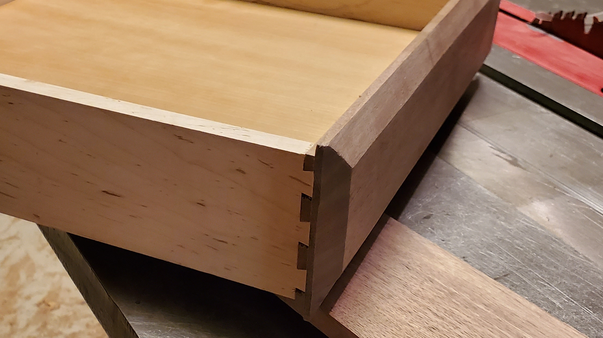
Dovetail jig

Slide 19
Chatting with LMM’s
- Large Language Models predict what comes next
- Prediction engine
- What can AI do for me?

Slide 20
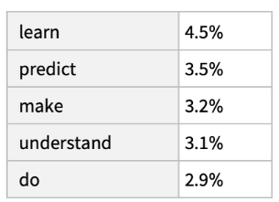
The best thing about AI is it’s ability to …

Slide 21
Prediction
The best thing about AI is its ability to,
The best thing about AI is its ability to learn,
The best thing about AI is its ability to learn from,
The best thing about AI is its ability to learn from experience,
The best thing about AI is its ability to learn from experience.,
The best thing about AI is its ability to learn from experience. It,
The best thing about AI is its ability to learn from experience. It’s,
The best thing about Ai is its ability to learn from experience. It’s not…

Slide 22
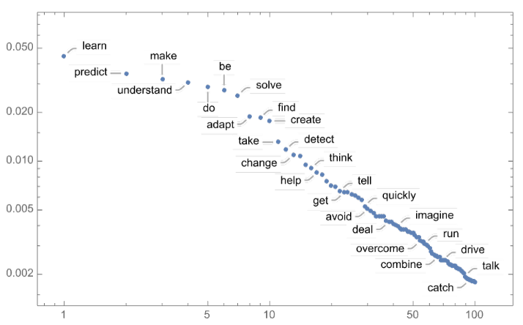
Power-law decay

Slide 23
Temperature
“The best thing about AI is its ability to learn from experience. It’s not just a matter of learning from experience, its learning from the world around you. The AI is very good example of this. It’s a very good example of how to use AI to improve your life. It’s a very good example of how to use AI to improve your life. The AI is a very good example of how to use AI to improve your life. It’s a very good example of how to use AI to…”

Slide 24
Lower the temperature…
The best thing about AI is its ability to learn. I’ve always liked the…
The best thing about AI is its ability to really come into your world and just…
The best thing about AI is its ability to examine human behavior and the way it…
The best thing about AI is its ability to do a great job of teaching us…
The best thing about AI is its ability to create real tasks, but you can…

Slide 25
Too low temperature?
“The best thing about AI is the ability to see through, and make sense of the world around us, rather than panicking and ignoring. This is known as AI “doing its job” or AI “run-of-the-mill” Indeed taking an infinite number of steps, developing a machine that can be integrated with other systems, or controlling one system that’s truly a machine, is one of the most fundamental processes of AI. Aside from the human-machine interaction, AI was also a big part of creativity…”

Slide 26
Embeddings
A vector representation of a piece of data
Search
Clustering
Recommendations
Anomaly detection
Classifications

Slide 27
Automation (verb) Why spend 6 minutes doing something by hand when you can spend 6 hours failing to automate it?

Slide 28


Slide 29
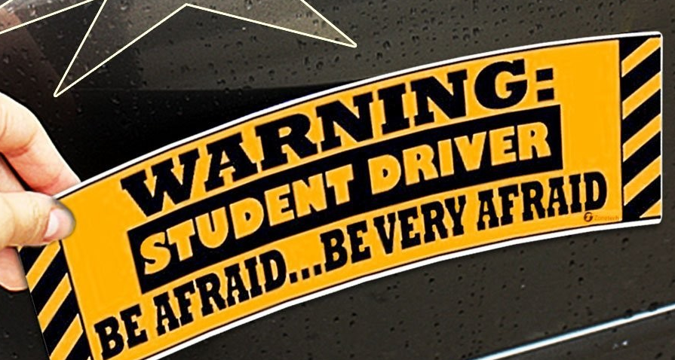
Copilot
How can I help?
Pay atterntion…

Slide 30
Now is not the time for fear That comes later.

Slide 31

OpenAI Service

Slide 32
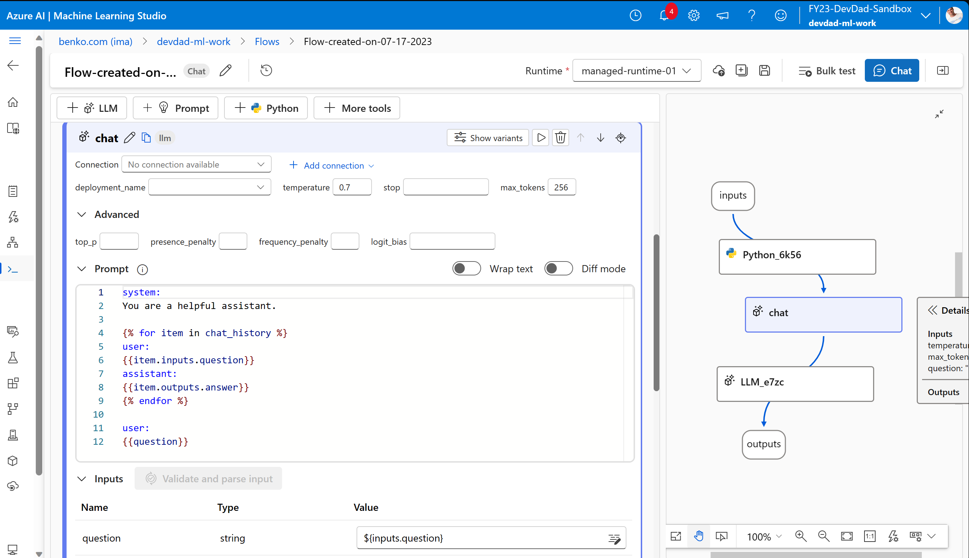
Promptflow

Slide 33
Lessons learned
Fear not…
Learn to ask better questions
Practice

Slide 34
Doing things right is not the same as Doing the right things

Slide 35
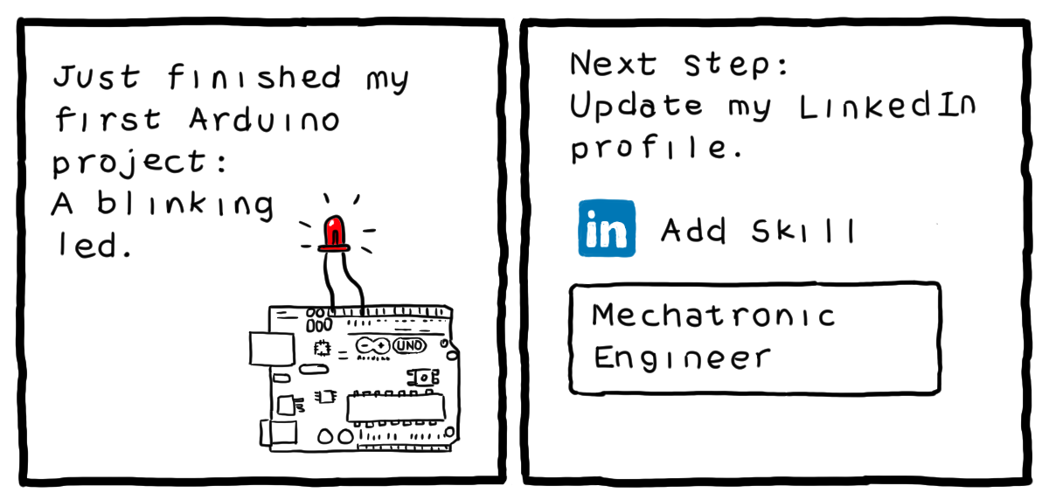
http://turnoff.us/geek/arduino-project/

Slide 36
Conclusion
The journey to the cloud can be challenging
Take it a step at a time
Be aware of the tools that can ease the way

Slide 37
Call to Action – Where can I get more info?
Visit my blog
www.benkotips.com
Schedule a workshop to make your IT workforce cloud aware
mike@benko.com
Az! https://bit.ly/BnkAzHrs
Try it out with low hanging fruit white chips

Slide 38
Life’s a journey, enjoy the ride!

Slide 39
References
What Is ChatGPT Doing … and Why Does It Work?—Stephen Wolfram Writings
Seth Juarez – Roshambo

Slide 40
